Slide 1
CNC Custom Manufacturing
Permac Industries
Small Metal & Plastic Parts Manufactured to Specifications

Slide 2
About Us
Founded in 1966
Privately Owned
Darlene Miller– President & CEO
Certified as a WBENC (Woman-Owned)
AS 9100D:2016 & ISO 9001:2015 Certified
ITAR Registered

Slide 3
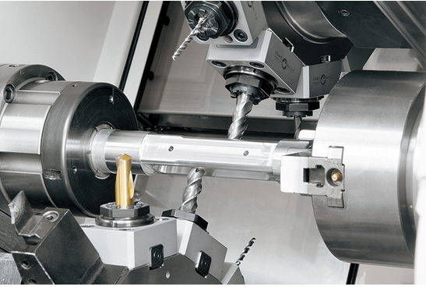
Profile
Precision machine shop focused on small parts
Core Competency and Capabilities
Over 50 years of small part machining experience
Career machinists – as both setup and operators
Optimized efficiency, quality, and DFM support
CNC Milling – metals & plastics
CNC Turning – metals & plastics 2 5/8” barfeed capacity
Swiss Machining – metals & plastics up to 0.787”
CNC EDM Hole Drilling – holes 0.004 - 0.118
Quick Turn prototype support – milling and lathe

Slide 4
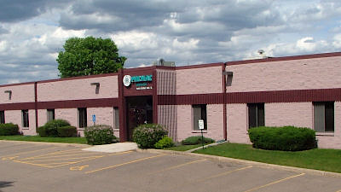
Profile Continued
Latest Technology Multitasking Machine Centers
Facility
Permac will provide exceptional quality in all stages of precision machining. Our clients recognize our dedication to continuous improvement, on time delivery, zero defects, and exceptional customer service.
IT IS OUR BUSINESS TO MAKE YOURS EASIER.
34,000 ft²
Built in 1985 with a large addition in 2007

Slide 5
Primary Markets
Aerospace: precision tolerance metal and plastic used in airframe, engines, and avionics.
Sensors, connectors, pumps, hardware components, etc.
Commercial: metals and plastics in beverage, food processing, and transportation
Valves, fittings, slicers, bushings, drives, packaging, etc.
High-Reliability Industrial: metals and plastics used in actuators, transducers, generators, and agriculture equipment
Housings, shafts, spacers, contacts, specialized mounts, etc.
Non-Implantable Medical: metals and plastics
Patient monitors, prosthetics, surgical tooling, mobility, etc.

Slide 6
Our Specializations
Permac is a reliable and proven machining source for small metal and plastic parts
Benchmark machining industry lead time and quality
Complex turned and milled parts
Low to medium quantities
High mix
Quick turn projects and prototypes
Light assembly
Standard lead time 6 weeks
Prototypes in less than 2 weeks
Kanban, Min-Max and customized Permac managed inventory
On time delivery and customer support

Slide 7
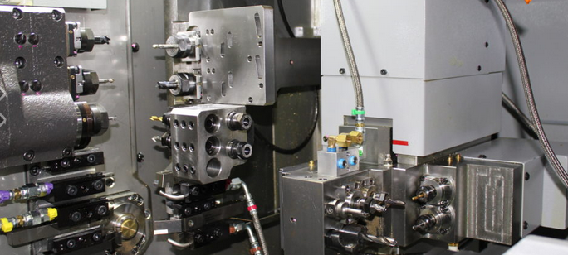
CNC Machined Parts

Slide 8
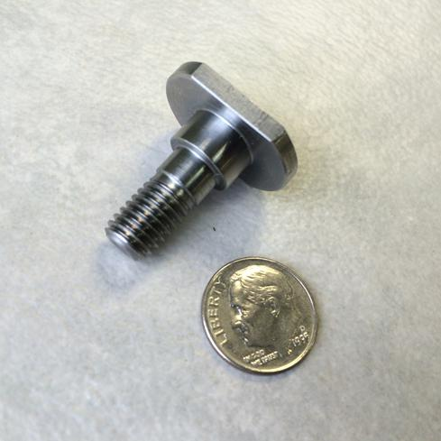
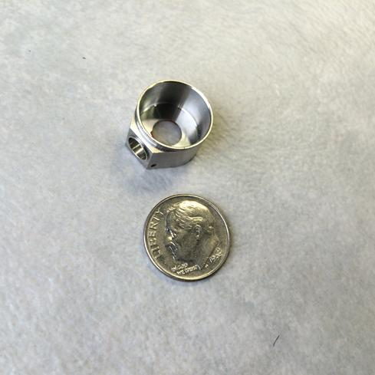
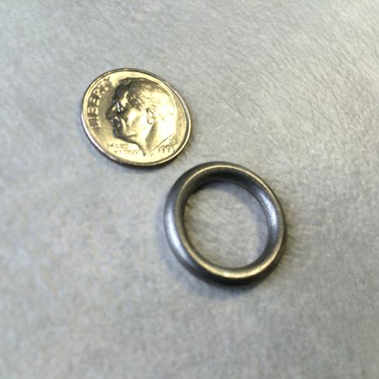
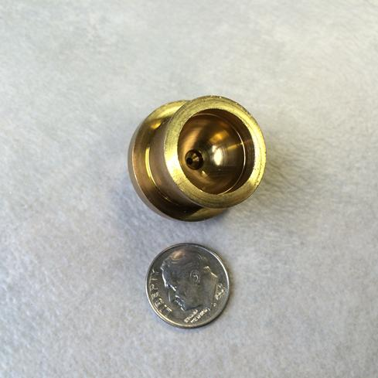
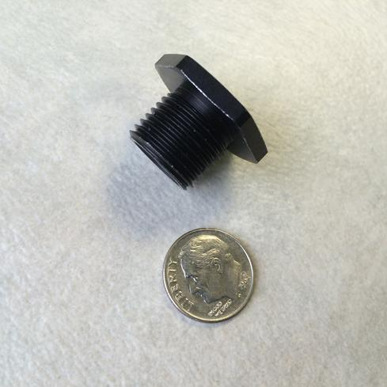
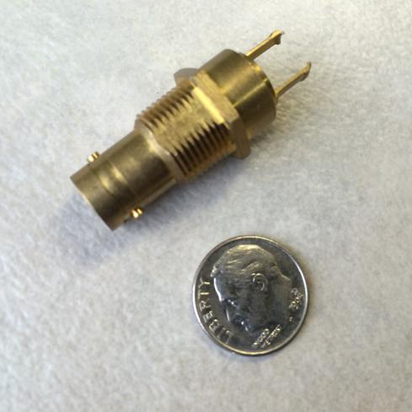
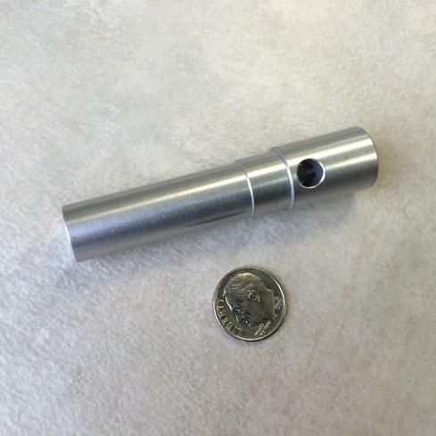
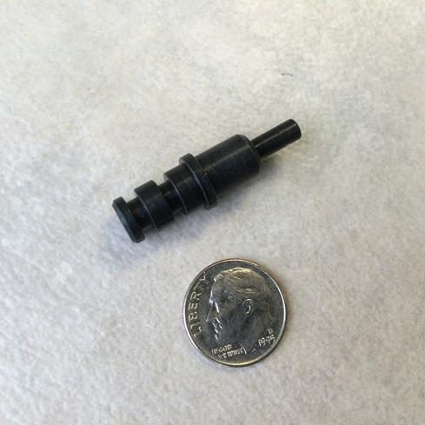
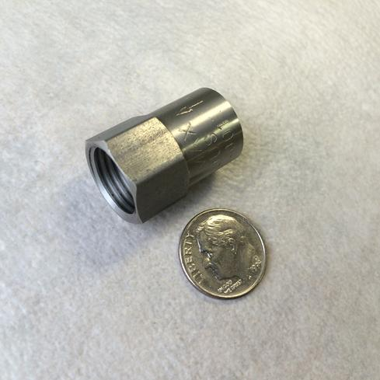
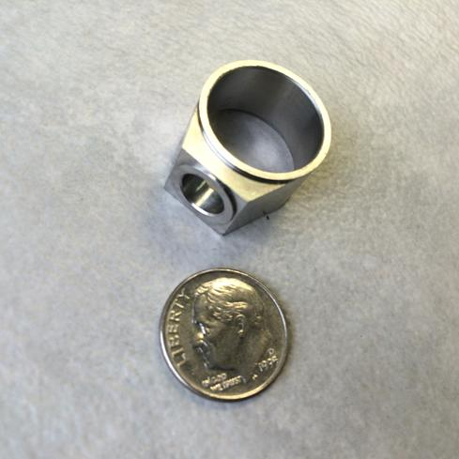
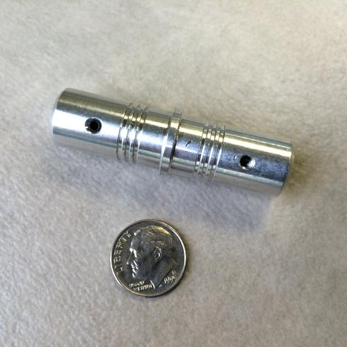
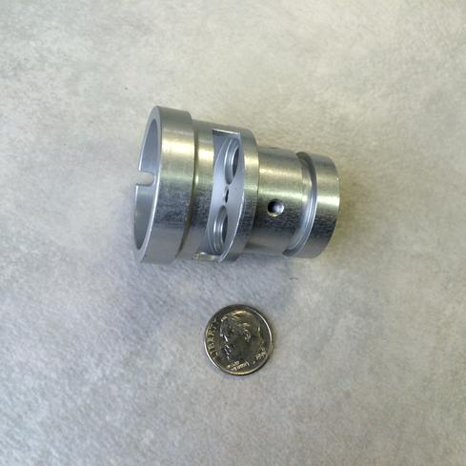
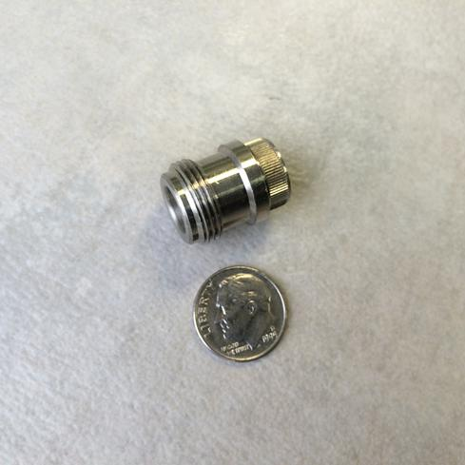
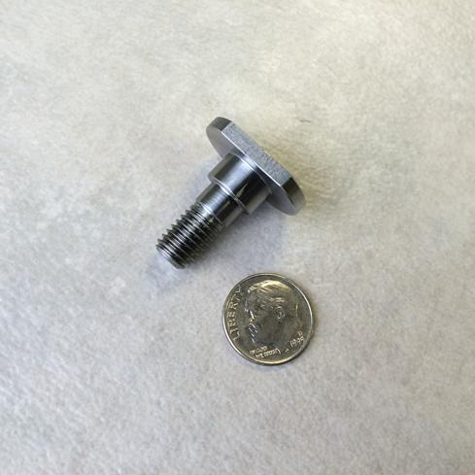
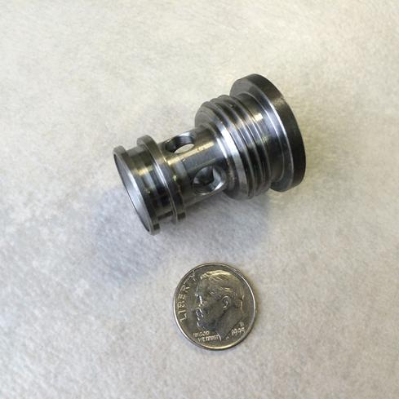

Slide 9
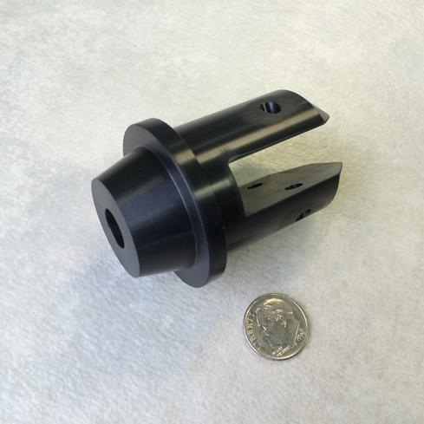
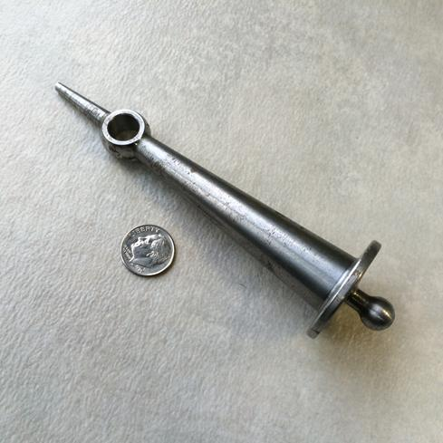
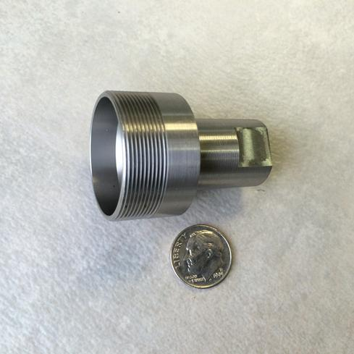
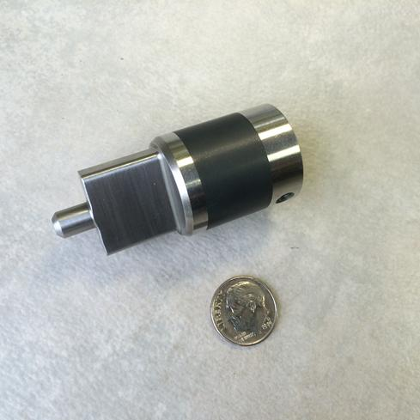
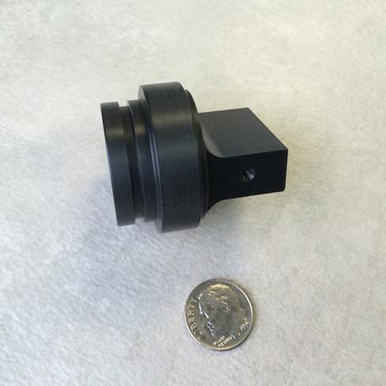
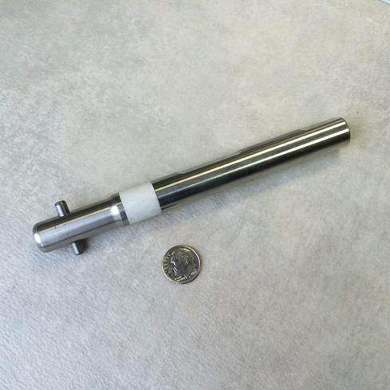
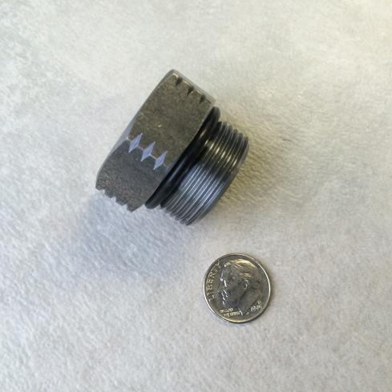
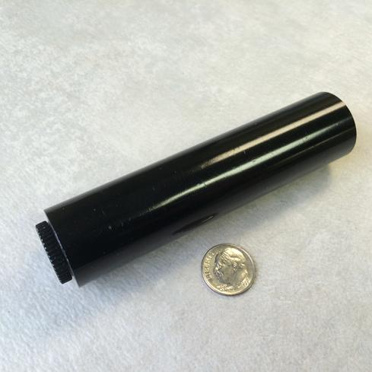
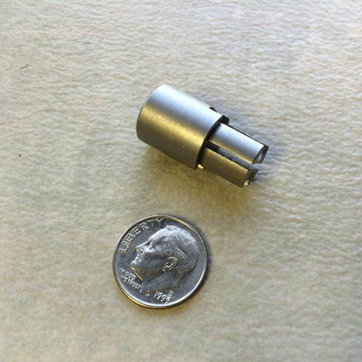
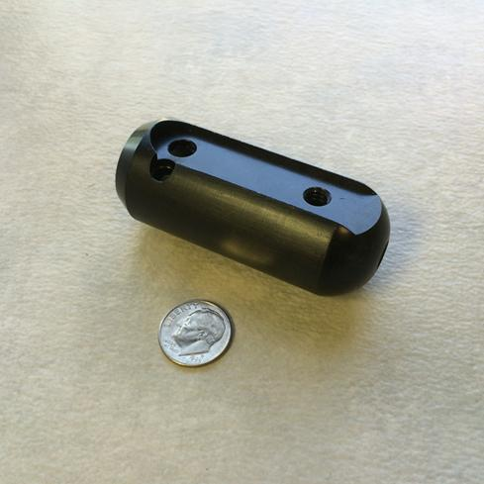
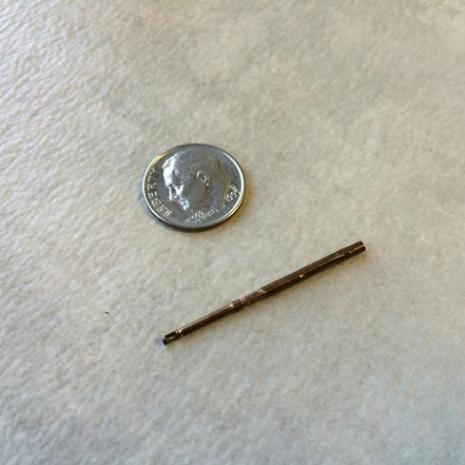
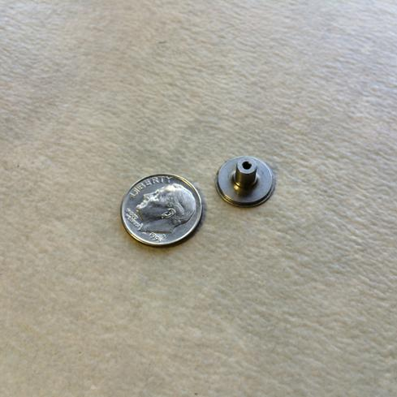
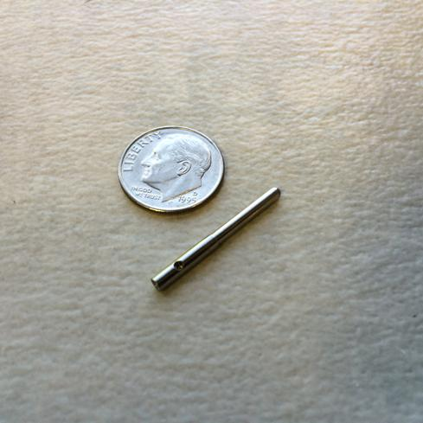
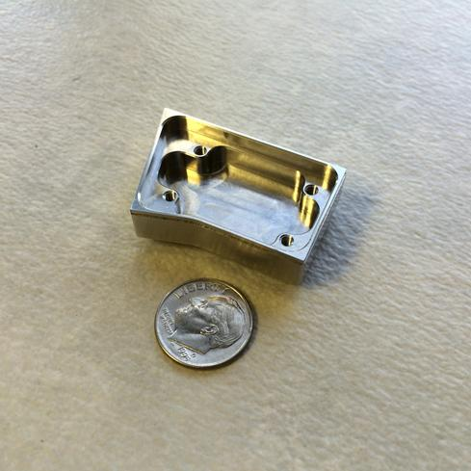
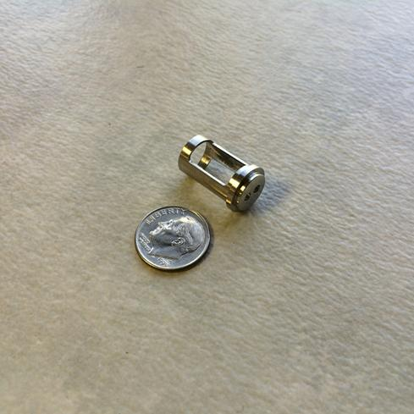

Slide 10
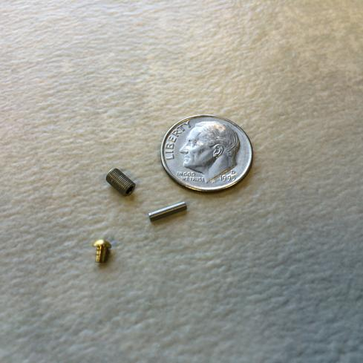
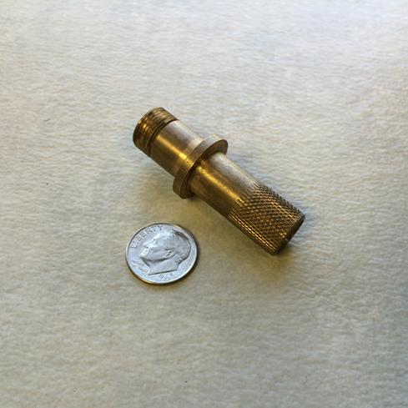
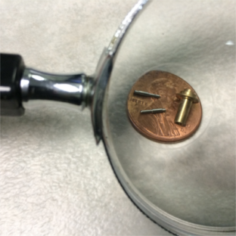
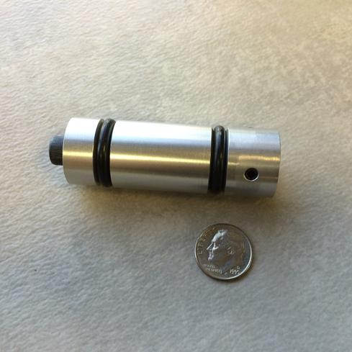
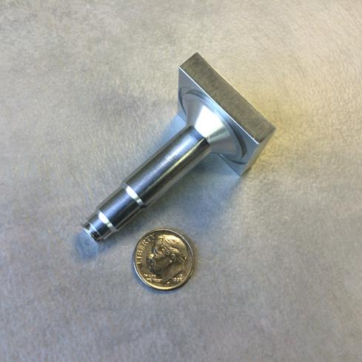
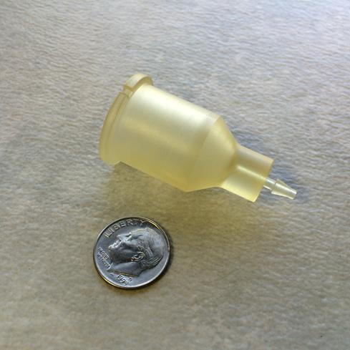
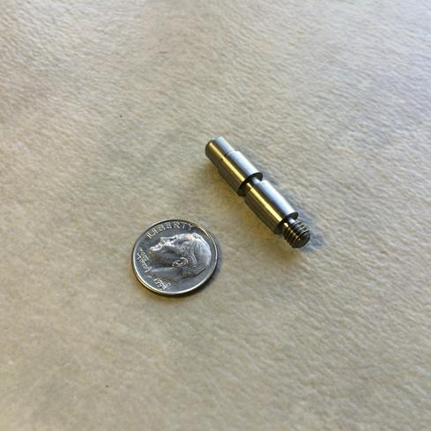
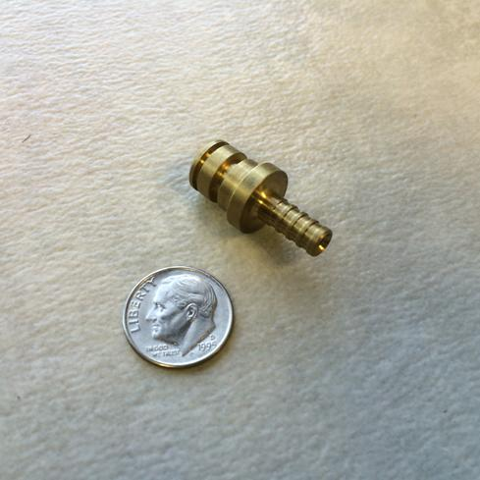
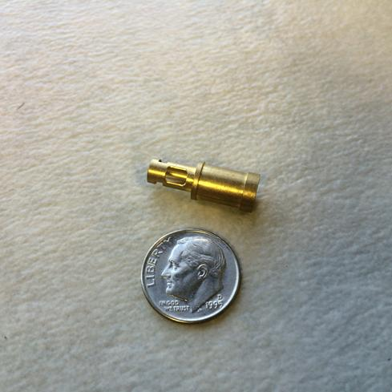
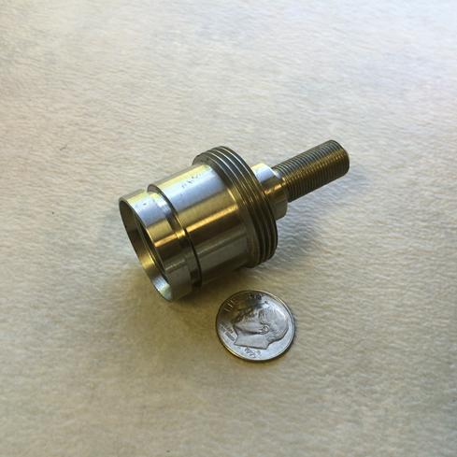
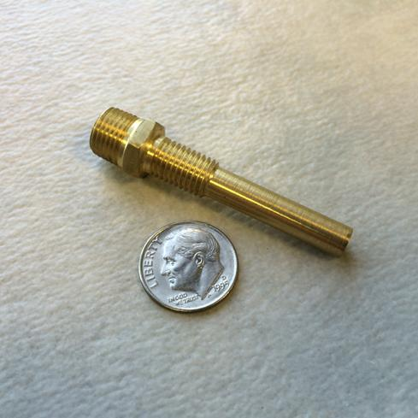
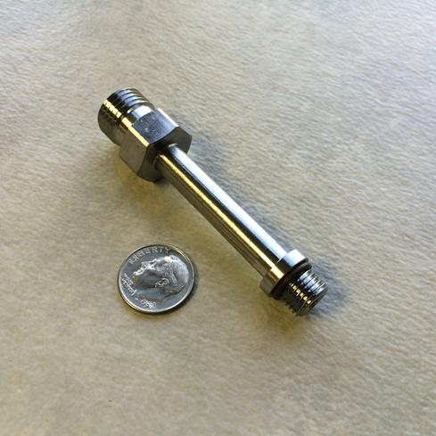
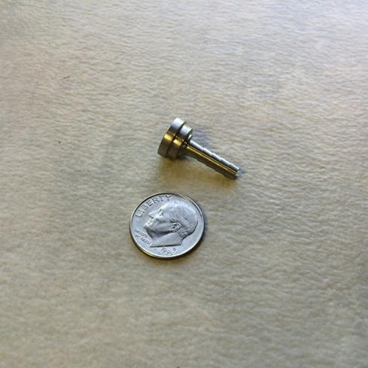
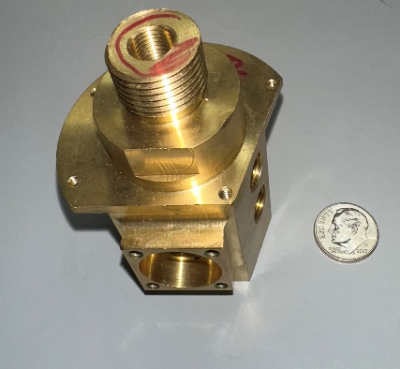
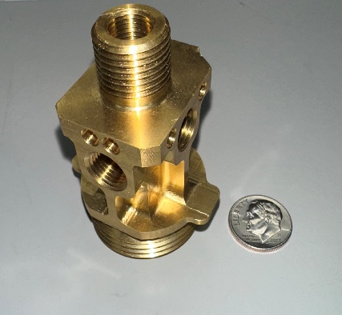

Slide 11
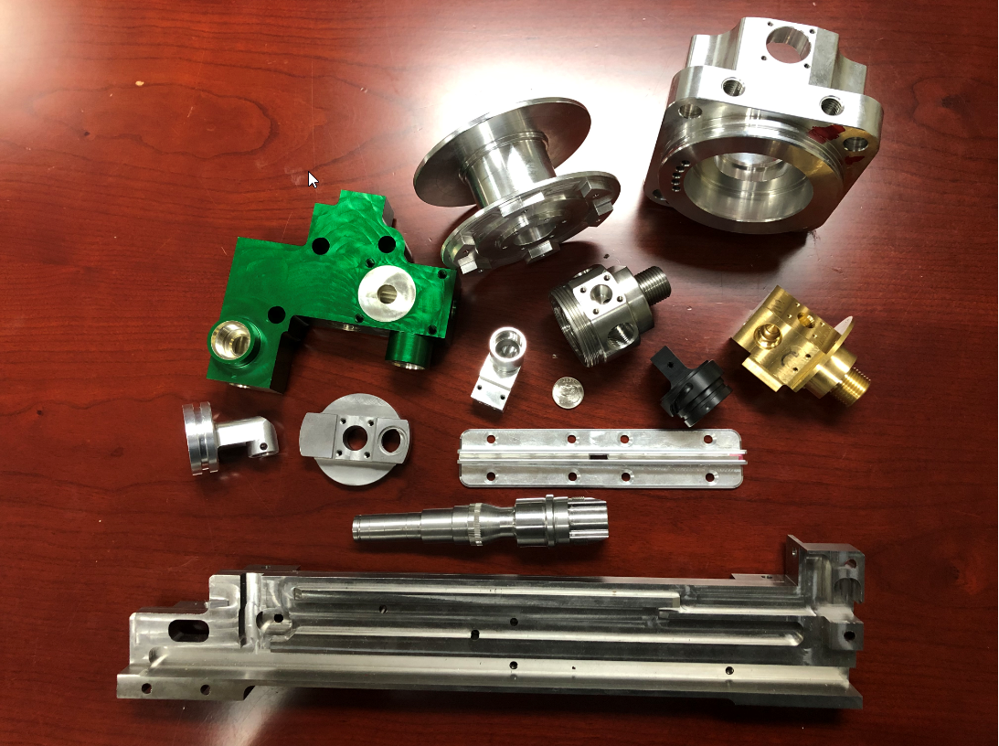
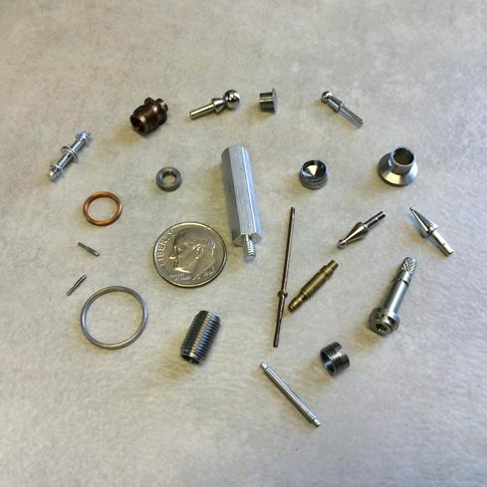

Slide 12
Equipment List
CNC Turning Centers
1 Okuma Cadet with Tail Stock and Cobot
CNC Milling Machines
1 Nakamura-Tome WY150 Twin turret/ twin spindle multi -tasking turning center, milling capabilities and 2 1/2” Barfeed capacity
2 Nakamura-Tome Super NTY3 3 turret/twin spindle multi-tasking turning center with 1-5/8” Barfeed capacity
1 Okuma Heritage lathe with tailstock and 4' auto loading Barfeed 1 5/8" capacity
1 Nakumura Super NTMX 2 5/8 with barfeed capacity
1 Haas TL1 Lathe
1 Okuma MC-V4020 Vertical Machining Center, 15,000 RPM with high speed milling capability
1 Okuma M560-V 15k Vertical Machining Center 15,000 RPM with high speed milling capability and 4th Axis
1 Haas TM2 CNC Rapid Prototype Vertical Machining Center with 4-axis
1 Haas DM-2 High Speed Drill/Mill Center with 15,000 RPM Spindle
CNC Swiss Turning Centers
1 Citizen L12 Type VII Swiss Turning Center – 12 mm capacity
1 Citizen L20 Swiss machine with sub spindle and milling capabilities 20 mm capacity
1 Tsugami BW209Z Swiss-Type Lathe with Dual Spindles, Dual Gang Slides and Nine Cutting Axis – 20 mm capacity
1 Tsugami S206-II Swiss type Lathe with oversized 1.000″ sub spindle and 6 linear axis – 20 mm capacity
1 Tsugami Bo2o5-III Swiss type Lathe with oversized 1.000″ sub spindle and 5 linear axis – 20 mm capacity
1 Nakamura-Tome WY100 Twin turret/ twin spindle multi -tasking turning center, milling capabilities and 2” Barfeed capacity

Slide 13
Equipment List Continued
CNC EDM and Cobot
Titan CNC EDM Drill
Rapid Prototyping and Secondary Operations
Model i60c 0.004 - 0.118 range
Universal Robot UR5e for assisting in assembly, machine tending, and secondary operations
Prototype Verticle Machining Center - Haas TM (travels of 40 x 16 x 16) 10 pocket tool changer
1 Bridgeport Mill Series 1
1 Birmingham Engine Lathe
1 Hardinge Hand Chucker
2 Hardinge Hand Screw Machines
2 HEM H100A Automatic Cut-off Saw
1 Kalamazoo 20-T-10 Vertical Saw
4 Dayton Drill Presses
1 Ultramatic Tumble Deburrer
1 Better Engineering Parts Washer
Spinner electronic deburring and polishing machine
Miscellaneous Deburring and Polishing Equipment
Kleer Flow Power Master Parts Washer

Slide 14
Inspection Equipment
Inspection
RAM Optical Instrument completely automated CNC, programmed operation for video, laser, and touch probe. Visual Inspection provides an array of benefits for different measurement applications and interactive or programmed measurement with precision manual control. It also provides a portable laser scanning system for high-resolution surface profiles. Inspection capabilities provide compact video inspection systems with comfortable, high-resolution viewing of parts and assemblies.
ZEISS O-INSPECT CMM
2 OASIS Inspection System - accurate to 0.0001 inches - Instant measurements
1 Mitutoyo Bench Indicator with .00002 Resolution
3 Optical Comparators with Digital Readouts and Optical Probes
3 Surfometer Surface Finish Gage with SPC and Skidless Capabilities
4 10X-40X Illuminated Stereoscope
3 Edmunds Electronic Columns
1 Mitutoyo 18” Height Master
Assorted Support Gage and Gaging Tools
1 Brown and Sharpe/Tesa Micro Height
Real-time SPC Data Collection Capabilities

Slide 15
Why Permac?
Experience
50+ years of proven experience as a reliable small part source
Capabilities
Precision CNC’s for milling, turning, EDM hole drilling, and Swiss machining at all volumes
Delivery
Customer scorecards reflect over 98% on time to dock date
Quality
Continuous improvement results in lowest DPM
Service
A team spirit and company mindset that the customer is #1

Slide 16
How Can We Help?
01. Production Parts
02. Prototypes
Lead times for parts at 6 weeks ARO. Quick turns are welcomed!
Dedicated cell for prototypes
03. Value Added
04. Managed Inventory
05. DFM
Parts can be assembled and packaged
Kanban, Min-Max, part family contracts, etc.
Materials, features, tolerances – suggestions for lowest cost

Slide 17
Thank you
When on time delivery, quality, lead time, support, and best overall value are needed, contact Permac Industries.
952.894.7231
mbartizal@permacindustries.com
Direct 952-746-0289
permacindustries.com
14401 Ewing Ave South, Burnsville, MN 55306

